Slide 1
EMAIL SPAM DETECTOR
2410030033 – T.Roopasri
2410030233 – CR.Pranavi
2410030248 – K.Swathi
2410030245 – J.Vishnuchethana

Slide 2
INTRODUCTION
Email is a popular way to send and receive messages. But sometimes, people get spam emails. These are unwanted messages that may be harmful or fake. They can try to steal personal information or damage your computer.
An Email Spam Detector is a tool that helps find spam emails. It keeps your inbox clean and safe. Today, we use smart computer programs (Python and Machine learning) to catch spam because spammers keep changing their tricks.

Slide 3
Problem Statement & Objective
Problem:
• Increasing email spam attacks worldwide.
• Limited research on multilingual and emotion-based spam detection.
Objective:
• Develop a robust email spam detector using ML algorithms.
• Improve accuracy with preprocessing and feature extraction techniques.

Slide 4
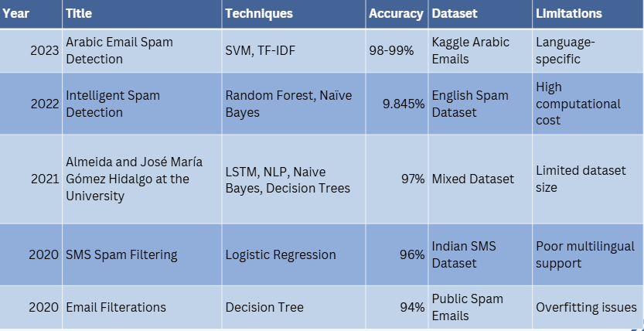
Literature Survey

Slide 5
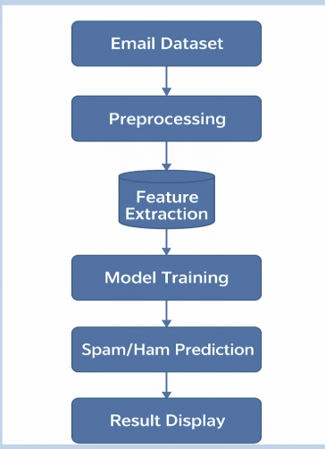
FLOWCHART

Slide 6



🛠️ Tools Used – Key Points
Kaggle (Dataset)
Python (Programming Language)
Jupyter Notebook / VS Code (Code Editor)
Pandas (Data Handling)
HTML / CSS (Frontend)

Slide 7
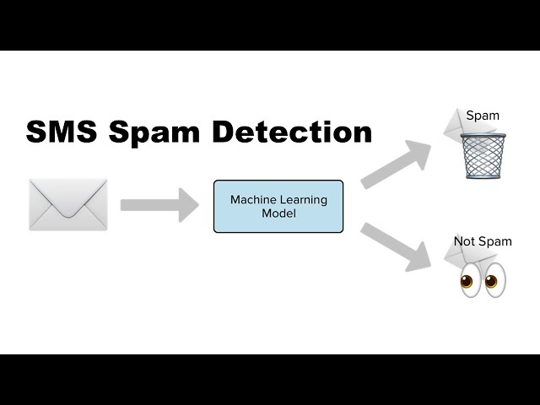
Visual Representation of Results
📩 Incoming SMS messages are passed into a Machine Learning model for classification.
📩 The model checks the message and labels it as either Spam (🗑️ sent to trash) or Not Spam ( kept for viewing).

Slide 8
Dataset Analysis Summary
Number of Records: 5,572
Number of Features: • label → category: ham or spam • message → text of the email/SMS
Class Distribution: • Ham (not spam): 4,825 (≈ 86%) • Spam: 747 (≈ 14%)
Balanced or Not: Not balanced → dataset is skewed toward ham messages.
Source: Created by Tiago A. Almeida and José María Gómez Hidalgo at the University of São Paulo, 2021.
Naive Bayes → ~97.5% accuracy
Support Vector Machines (SVM) → ~96.7% accuracy
Decision Trees → ~95% accuracy

Slide 9
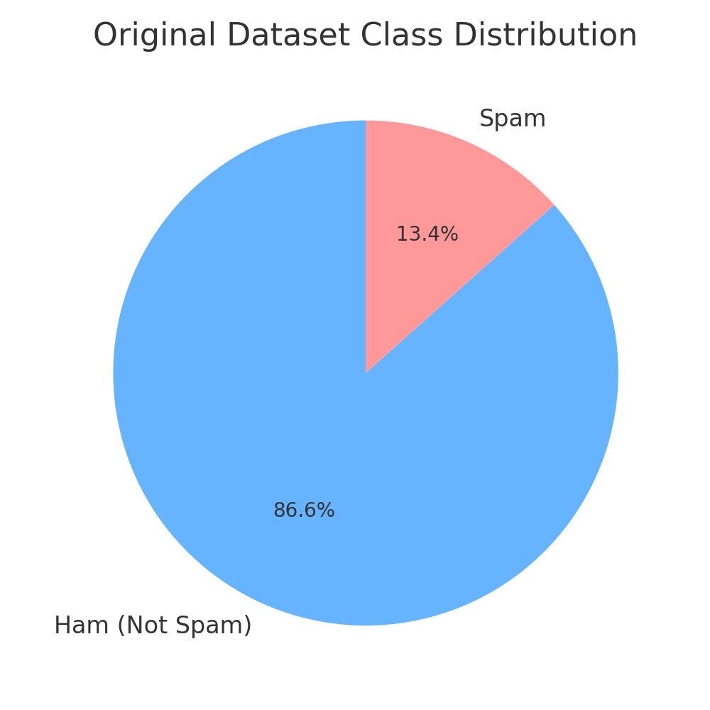
Implementation of Proposed Methodology
Language: Python
Libraries: Pandas, scikit-learn, string, TfidfVectorizer
Environment: Jupyter Notebook / VS Code
Dataset: 5,572 records (86% ham | 14% spam)
Model: Multinomial Naïve Bayes
Vectorization: TF-IDF
Evaluation Metrics: Accuracy, Precision, Recall, F1-Score

Slide 10
Architecture of Methodology Used in the Existing System
Existing System Overview – The existing spam detection systems typically use traditional machine learning algorithms such as
1. Naïve Bayes
2. Support Vector Machines (SVM)
3. Decision Trees
These models focus on extracting keyword frequency-based features and classifying messages as spam or ham.
Parameters for Optimization –
1. Accuracy, Precision, Recall, F1-Score
2. Choice of vectorization technique (CountVectorizer / TF-IDF)
3. Training–test ratio

Slide 11
Performance Analysis and Comparison
Model | Accuracy (%) | Precision | Recall | F1-Score
Decision Tree | 95.0 | 0.94 | 0.92 | 0.93
SVM | 96.7 | 0.96 | 0.95 | 0.96
Naïve Bayes (Proposed) | 97.5 | 0.98 | 0.97 | 0.97

Slide 12
Gaps or Limitations Identified from Literature Survey
Observed Limitations:
Most existing systems are trained on imbalanced datasets, causing bias toward “ham” messages.
Limited focus on data augmentation or improving spam diversity.
Feature extraction methods like Bag-of-Words fail to capture semantic meaning.
Some models lack real-time user interaction or adaptability to new spam patterns.
Converted into Project Objectives (Unaddressed Objectives):
To improve dataset balance by introducing synthetic spam data for better model learning.
To develop a TF-IDF-based Naïve Bayes model that enhances spam classification accuracy while remaining computationally efficient.

Slide 13
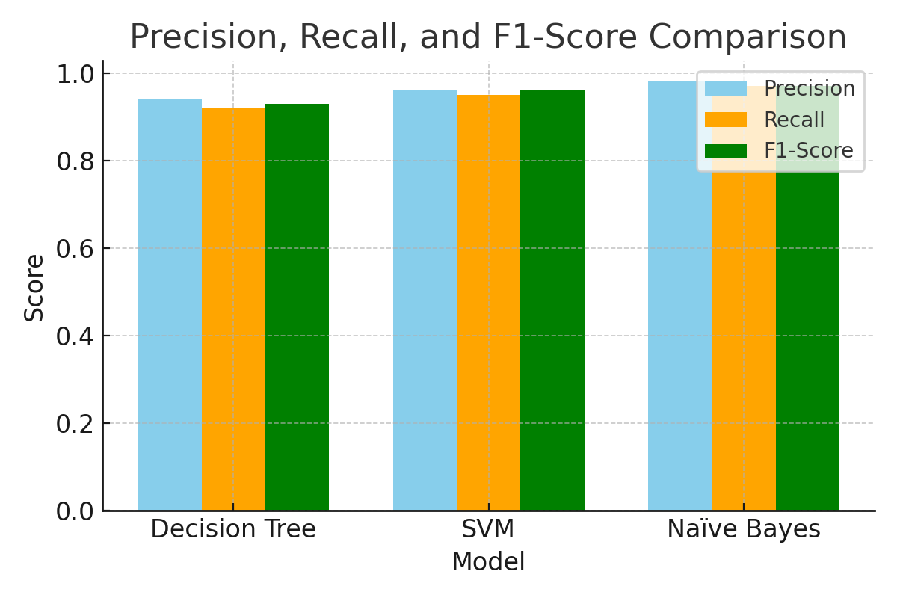
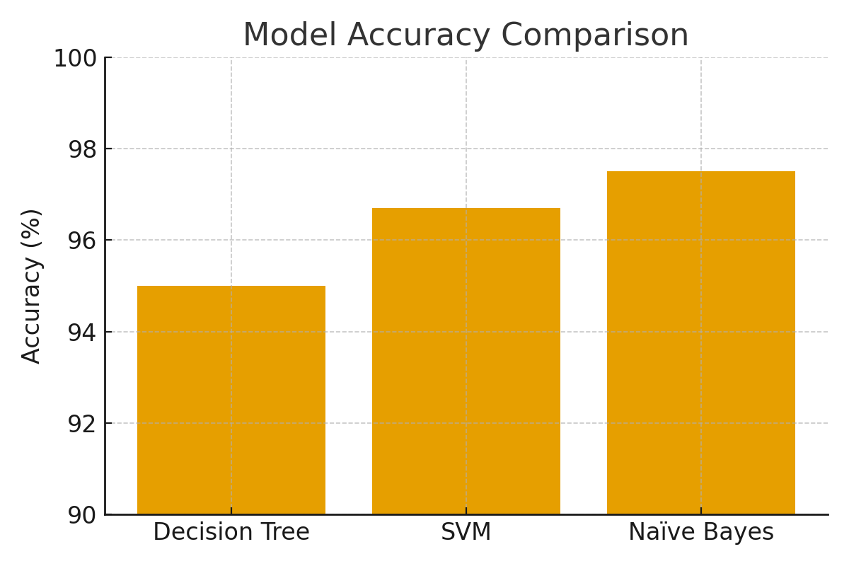
ANALYSIS AND GRAPHICAL REPRESENTATION

Slide 14
Conclusion
The proposed Multinomial Naïve Bayes model using TF-IDF vectorization effectively detects spam messages with an accuracy of 97.5%. By augmenting the dataset and optimizing preprocessing, the system achieves high precision and recall, ensuring efficient, reliable, and real-time spam classification for text-based communication.

Slide 15
THANKYOU

